Slide 1


Retail Management
System
Bhandarkars’ Arts & Science College
22-October-2021

Slide 2
Bhandarkars’ Arts &
Science College Kundapura
Guided By :
Mrs. Vijaylaxmi
Presented By:
Nagendra Herele,
Hrishikesh,
Rajesh

Slide 3
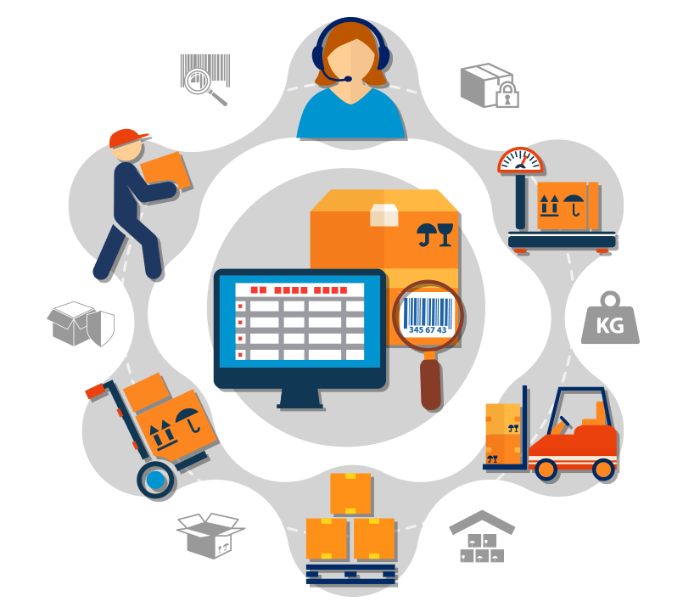
Developers
Nagendra Herele,
Hrishikesh,
Rajesh

Slide 4
Synopsis
Title of the project
Retail Management System
Objectives of the project
Main objective of this retail management system is the set of business
activities that adds value to the products and services sold to consumers
for their personal or family use.
Project Category
Relational Database management System.
Language(s) to be used
Front End: python, tkinter
Back End: Sqlite3
Structure of program

Slide 5
Analysis
This project is designed to manage a retail store system . In this
project we can manage purchase details, sales details ,product
record , categories detail and supplier record.
Module Description
Login
It is used to set the authentication of the user
before giving access to the software.
Administrator
Employee
Manage Employee
Add
It allows the admin to add the employee details
Delete
It allows the admin to delete the employee details

Slide 6
Update
It allows the admin to update the employee details
View
It allows the admin to view the employee details.
Supplier
Manage Supplier
Add
It allows the admin to add the supplier details
Delete
It allows the admin to delete the supplier details
Update
It allows the admin to update the supplier details
View
It allows the admin to view the supplier details.
Product
Manage products

Slide 7
Add
It allows the admin to add the product details
Delete
It allows the admin to delete the product details
Update
It allows the admin to update the product details
View
It allows the admin to view the product details.
Bill
Customer bill details
In this section details about the bills are listed allows the admin
to manage bill details.
Exit
It allows the admin to logout.
Employee
Manage Bill
This module allows the employee to make the bill of the
customer.

Slide 8
Data Structures
Admin
Aid
name
password
Employee
user_id
name
doj
mobileno
password
utype
Supplier
id
name
mobile_no
Productt
prod_no
category

Slide 9
id
item_no
item_name
price
iqty
status
Any other information
Not Applicable
Future Scope
In future online purchasing can be upgraded .

Slide 10
Software Requirement Specification
Introduction
The software requirement specification is the document that describes what the
proposed software should do without describing how the software will do it. Software
requirement specification fully describes non-functional function, design constraints
and other factor necessary to provide a complete and compressive description of the
requirement of the software.
The software requirement specification documents enlist enough and necessary
requirement that one required for the project development to derive the requirement we
need to have the clear add through understanding of the product to be developed or
being developed.
Software requirement specification defines how the intended software will
interact with hardware, external interface, speed of operation ,response time of system
,probability of software access various platforms ,speed of recovery after crashing
,security ,quality ,limitation etc.

Slide 11
Purpose
The purpose of the SRS documents is to bridge the communication gap between
the developer and the client. It acts as a medium to which the clients and the users need
are accurately specified. It also describes the external behaviour of the project.
Another purpose of software requirement specification document is to provide
a detailed of our software product is parameter and goals.
Scope
SRS documents provide a reference for validation of the final product . A high
quality SRS is a prerequires to high quality software . In future one can refer the
following SRS to extend the same software by refining this SRS document other
developer can develop and extend this software to network level . It specifies basic
requirement constraints and interfaces for the proposed system.
Definition, Acronyms and Abbreviations
GUI- Graphical User Interface
Reference
An integrated approach to software Engineering – Pankaj jalote .

Slide 12
Overview
Overview describes the complete overview of requirement document.
Section 1 | This section describes the document purpose and project scope. This section also includes definition and reference used throughout the document.
Section 2 | This section provides the product perspective and the key function of product .This section also describes the uses of the project and the characteristics of the system user.
Section 3 | This section describes the external interface, functional requirements, performance requirements, design constraints and the system attributes.
Overall Description
This section describes the function of the project and their aim. It also includes
the constraints and requirements of the project.

Slide 13
Product Perspective
Product perspective is essentially the relationship of the product to other
products defining whether the product is independence or is a part of
longer product function.
Product Function
The main function of the product is to provide service to the customer.
The admin an employee maintains information such as bill details ,sales,
product information.
User Characteristics
The user should know basic operation of the computer system as well as
basic idea to work with application.
General Constraints
This project runs on device powered by windows. The project developed
using python and SQLite3.
Assumption and Dependencies
The basic assumption is made about end users that they should be
computer literate. The retail store requires internal to use this application

Slide 14
Specific Requirement
The specific requirement section describes all the details that the software
developer to know for designing and developing the software.
External Interface Requirement
The external requirement section needs all the interaction of the software
with people, hardware and other software.
User Interface
A user interface section specifies a person controls software application
or hardware device. A good user interface provides a user friendly
experience allowing the user to interact with the software or hardware
in natural way. Nearly all software programs have graphical user
interface in which user can select using mouse on keyboard.
Hardware Interface
RAM – 2 GB
Hard disk – 32 GB
Software Interface
Windows operating system with version 8 or above.
2.3.1.4 Communication Interface
Not Applicable.

Slide 15
Functional Requirements
Login
Input
user_id
password
Process
User is verified by their user id and password.
Output
Validation and respective user interface will be displayed.
Administrator
Employee
Manage Employee
Add
Input
user_id
name
doj
mobileno
password
utype

Slide 16
Process
Collect the employee details which need to be update.
Output
The updated details will be stored in the database.
Delete
Input
user_id
Process
the id of the employee collected will be deleted.
Output
The details of the deleted employee will be updated.
View
Input
Invoking the module.
Process
Retrieves data from table and display to the admin.
Output
The details of all the employee.

Slide 17
Supplier
Manage Supplier
Add
Input
id
name
mobile_no
Process
This allow the admin to add the suppliers.
Output
The details of the suppliers will be stored.
Update
Input
Id
name
mobile_no
Process
This allow the admin to update the suppliers
information.
Output
The updated suppliers details will be stored.

Slide 18
Delete
Input:
Id
Process:
This allow the admin to delete the supplier.
Output:
The details of the deleted supplier will be updated.
View
Input:
Invoking the module.
Process:
The details of the information will be Retrieved from
Database.
Output:
The details of supplier will be shown.
Products
Manage products
Add

Slide 19
Input:
category
id
item_no
item_name
price
iqty
status
Process:
This allow the admin to add the product.
Output:
The details of the products will be stored.
Update
Input:
category
id
item_no
item_name
price
iqty
status
.

Slide 20
Process
This allow the admin to update the product.
Output
The updated products details will be stored.
Delete
Input
prod_no
Process
This allow the admin to delete the product.
Output
The details of the deleted products will be updated.
View
Input
Invoking the module.
Process:
The details of the information will be Retrieved from database.
Output:
The details of product will be shown.

Slide 21
Bill
Customer Bill Details
Input
bill_no
Process
Here admin will be able to view the customer bill.
Output
The customer bill details shown.
Exit
Input
Invoking the module.
Process
The admin logout from the module.
Output
The admin exit from the module.
Employee
Manage bill

Slide 22
Input
prod_no
category
item_no
item_name
price
iqty
status
Process
Here employee will be able to make customer bill.
Output
The customer bill details shown.
Performance Requirements
Static Requirements
Static requirements are those that do not improve constraints on the
execution characteristics of the system. These include requirements like
number of terminals to be supported and the number of simultaneous
users to be supported.

Slide 23
Dynamic Requirements
Dynamic requirements specifies constraints on the execution behaviour
of the system. These typically include response time and throughput
constraints on the system.
Design Constraints
Hardware Constraints
The development of this application requires a computer system with intel core
i3 processor; 2GB RAM with 4GB dedicated graphics and 1 TB hard disk.
Software Constraints
The application development requires windows 8 or higher version of operating
system. Python 3+ version tkinter and SQLite3 database.
Fault Tolerance
Fault tolerance is the property that enables a system to continue
operating property in the event of the failure of same of its components.
The validation for input data and user level management by proper
authentication and authorization will add this software to be fault
tolerance.
Security
The project provides security of the data and only the authorised users
can access the data. This is authorised using user id and password.

Slide 24
Standard Compliance
The software is designed in such a way that meets the existing standard.
The software has graphical user interface to ease of the user.
System Attributes
Maintainability
This application will be developed in such a way that it can be
modified.
Availability
Application availability to use in most operating system. All the
data is made available data server.
Reliability
This application is reliable because it gives the designed result
when used.
Other Requirements
Not applicable.

Slide 25
System Design
Introduction
The design activity starts when SRS for software to be developed is
available. It is the first step that was moving from problem to solution domain.
It is blueprint of plan for system. It has two levels. First is system or top-level
design which is the process of defining elements of system such as architecture
modules and components. Different in interface of these components and the
data that goes through that system it is systematic approach to design or system.
It has major on testability, modifiability, and efficiently of the system. At the
end of system design all the major data structure file formats, output formats
and major modules in the system and their specification are decided.
Applicable document
Synopsis
Software Requirement Specification
Functional decomposition
It is useful for understanding the modules nature of largescale application.
Similarly, retail management store application has eight modules. This system consists
of some modules and each module consisting of sub modules of the system can be represent as hierarchy components

Slide 26
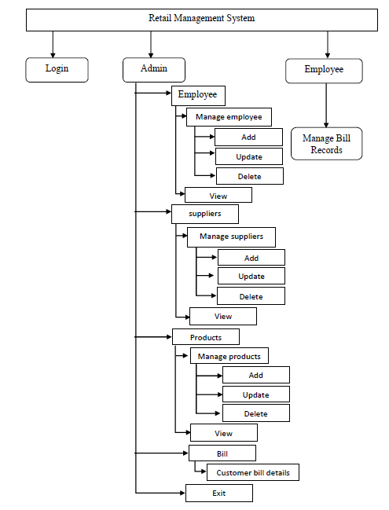

Slide 27
Functional Components
This section identifies functional components of the software. In this
project main function and components are
Login
The employee or admin must enter the valid user id and password. On
successful login it allows to access modules.
Administrator
Employee
Manage Employee
Add
The added employee details will be stored in the database.
Update
The updated details will be stored in the database.
Delete
The deleted details will be stored in the database.
View
The details of all the employee will be displayed

Slide 28
Supplier
Manage Supplier
Add
The added supplier details will be stored in the database.
Update
The updated supplier details will be stored in the database.
Delete
The deleted supplier details will be stored in the database.
View
The details of supplier will be shown.
Products
Manage Product
Add
The added Product details will be stored in the database.
Update
The updated Product details will be stored in the database.
Delete
The deleted Product details will be stored in the database.

Slide 29
View
The details of Product will be shown.
Bill
Customer Bill Details
The customer bill details shown.
Exit
The admin exit from the module.
Employee
Manage bill
Employee will be able to make customer bill.
Description of the program
Context flow diagram
The context flow diagram shows the output and output of the system. It
shows all the external entities that interact with the system and how the
data flows between these external entities and the system.

Slide 30
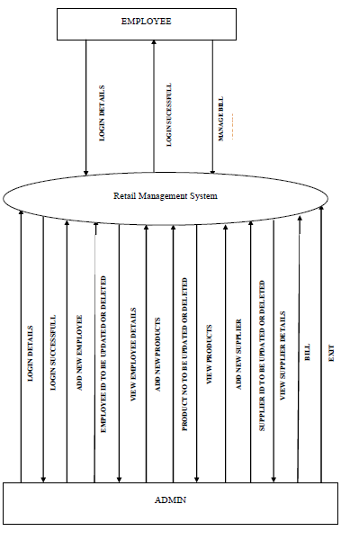

Slide 31
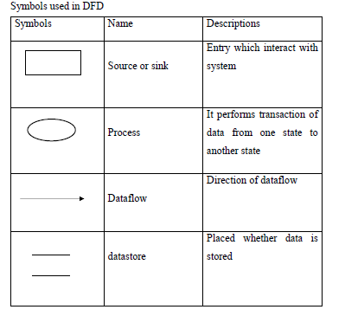
Top level DFD
The data flow diagram flow of data through a system. It views system as a
function that transaction the input into designed output. It contains number of system
symbols that is used to represent the system. DFD describes about the modules and
heir attributes in such a manner that each and every one understand it correctly.

Slide 32
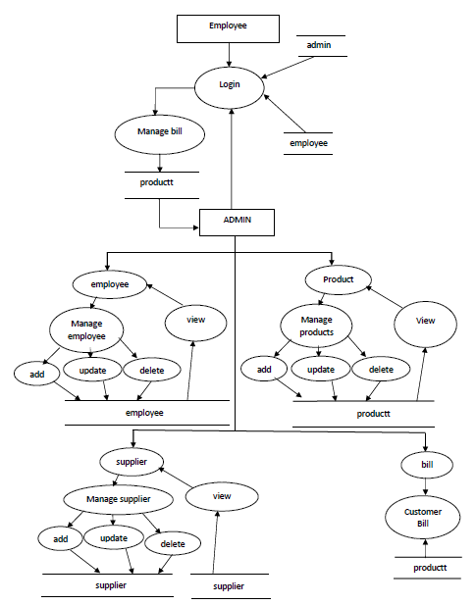

Slide 33
Description of components
Login
Input
user_id
password
Process
Account verified by id and password.
Output
On successful authentication user can access the information
Interface with other functional components
Not applicable
Resource allocation
employee, admin
User interface
Text: To enter valid information.
Button: click on the to get login.
Label: Display the details.
Frame: Grouping and organising other widgets.
Window: Contains other widgets.

Slide 34
Administrator
Employee
Manage Employee
Add
Input
user_id
name
doj
mobileno
password
utype
Process
Admin can add employee details
Output
The added employee details will be stored in database.
Interface with other functional components
Login
Resource allocation

Slide 35
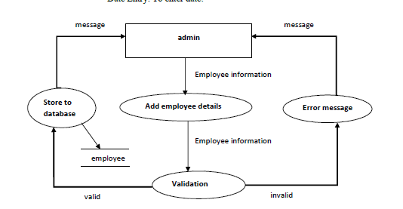
User interface
Entry: To enter valid employee information.
Button: click on the ADD button to store the data.
Label: Display the details.
Tree View: Display the records.
Date Entry: To enter date.

Slide 36
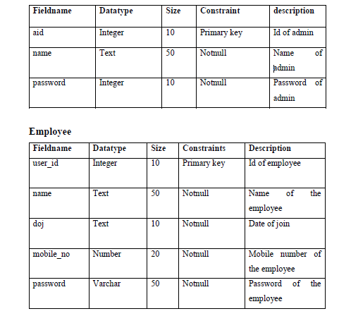
DATABASE DESIGN
Introduction
This document describes the tables that are used to design software, its attribute,
datatypes, constraints and relationship among their tables. Database is a collection of
data in a table on relationship database. The data stored in a a relation are arranged in
tables on records. Each record consist of a set of attribute on field can consist of
attribute. This data model contains all the needed logical and physical design choices
and physical storage parameters needed to generate a design in a data definition
language, which can be used to create a database.
Description of the table and fields
Admin

Slide 37
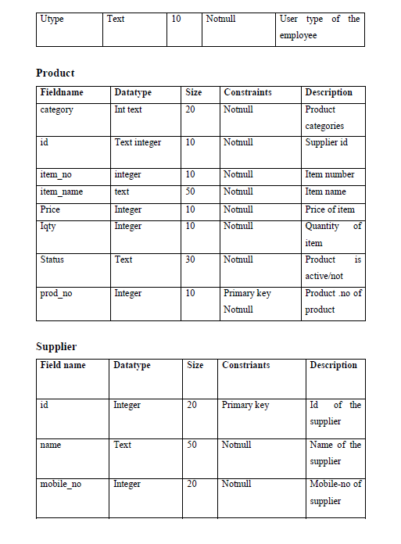

Slide 38
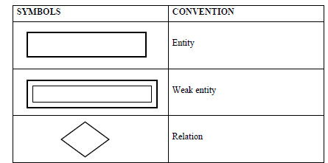
4.3 E-R diagram:
The relation among the tables is defined by E-R diagram. A diagrammatically
representation of relationship between an entity and it's attribute is reffered to as an
diagram.
A entity may be an object with physical on conseptual existence. The properties
that one used to describe the entity are called attribute. Entity that do not have key
attributes of their own is called identifying types. A weak entity type always has total
participation constraint with represent to its identifying relation symbol, notation and
their description used in drawing .
E-R diagram symbols as follows:

Slide 39
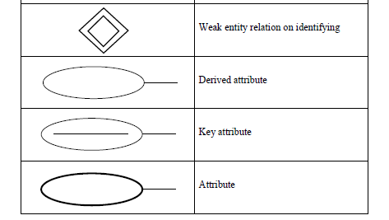
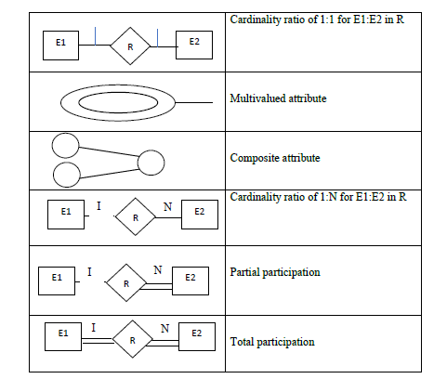

Slide 40
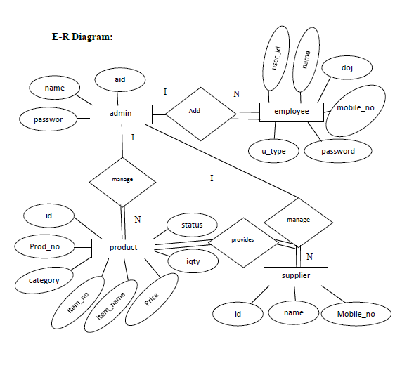

Slide 41
DETAILED design
Introduction
The design process for developing software system companies design activities
at two levels.
The top level is called the system design that identifies and defines various
modules on components as needed by the system and specify as to how modules interact
with each other. Whereas the second level called the detailed identifies and develops a
detail description on internal processing logic of each module of the system that can be
located from top level system design.
The detailed design is an extension of the system design and design can be easily
implemented precise description internal logic of respective modules along with their
data structure is readily available. However ,the detailed design can be initialized and
process further with a confirmation that all the modules in the system design are
specified precisely.
Applicable Documents
System Design
Database Design
Structure of software package

Slide 42
Login
5.3.2 Admin
5.3.2.1 Employee
5.3.2.1.1 Manage employee
Add
Delete
Update
View
Supplier
Manage supplier
Add
Delete
Update
view
Products
Manage products
Add
Delete
Update

Slide 43
View
Bill
Customer bill Details
Exit
Employee
Manage bill
Modular decomposition of components
Login
Design assumption
All fields are mandatory
Identification of modules
This modules allows the added employee and admin to login using id and
password.
Showing hierarchy of login module

Slide 44
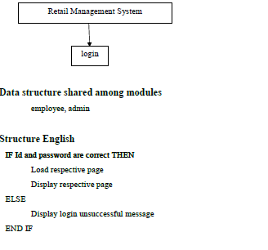

Slide 45
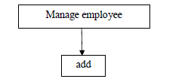
Administrator
Employee
Manage Employee
Add
Design assumption
All fields are mandatory
Identification of modules
This modules permits to add the employee.
Showing hierarchy of employee module

Slide 46
Data structure shared among module
employee
Structured English
IF employee details valid THEN
IF employee already there THEN
Display employee exist.
ELSE
Store to database and display added successfully.
ELSE
Display unsuccessful message.
END IF
Delete
Design assumption
All fields are mandatory
Identification of modules
This modules allows to delete the employee.
Showing hierarchy of employee module

Slide 47
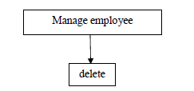
Data structure shared among module
employee
Structured English
IF employee details valid THEN
Display employee deleted and store to data base.
ELSE
Display error message.
END IF
Update
Design assumption
All fields are mandatory
Identification of modules
This modules allows to update the employee

Slide 48
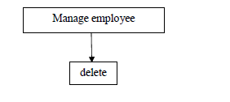
Identification of modules
This modules allows to delete the employee.
Showing hierarchy of employee module
Data structure shared among module
employee
Structured English
IF employee details valid THEN
Display employee deleted and store to data base.
ELSE
Display error message.
END IF
Update
Design assumption
All fields are mandatory
Identification of modules
This modules allows to update the employee

Slide 49
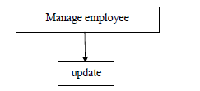
Showing hierarchy of employee module
Data structure shared among module
update
Structured English
IF employee details valid THEN
Display employee update and store to data base.
ELSE
Display error message.
END IF
View
Design assumption
Employee database

Slide 50
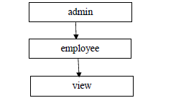
Identification of modules
This modules shows the employee records.
Showing hierarchy of view module
Data structure shared among module
view
Structured English
Load employee Database
Display employee record.
Detailed design
Structured chart
Structured charts is the graphical representation of each modules.
Rectangle is determined as module. An arrow from one module indicates its
invocation where the invoking module superior ordinate module and invocation
module is subordinate module.

Slide 51
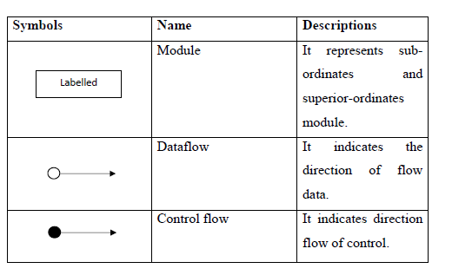
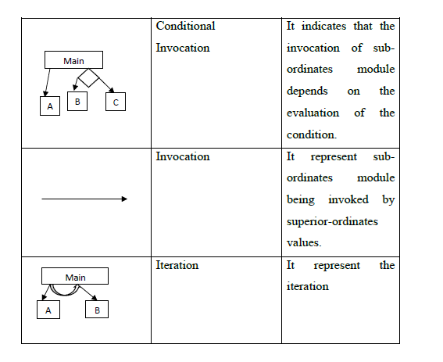

Slide 52
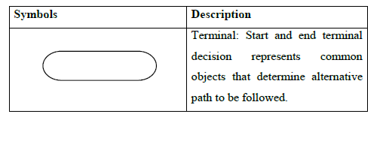
Flow chart
A flowchart is a type of diagram that represent an algorithm. Work flow or
process. The flow chart shows the steps as boxes of various kinds and their by
connecting the boxes with arrows. Flowchart is used in analysing, designing
documenting or managing a process or program in various fields.

Slide 53
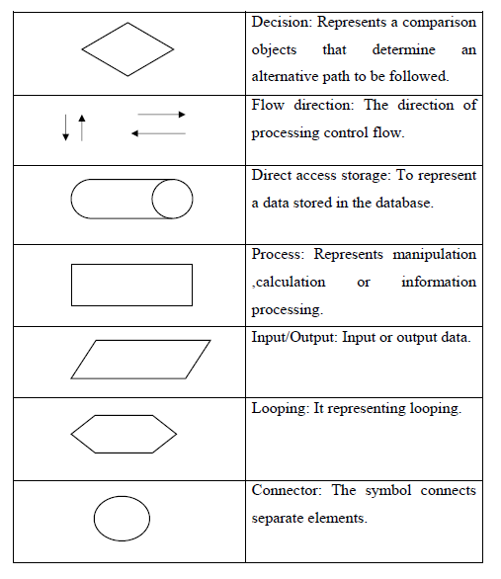

Slide 54
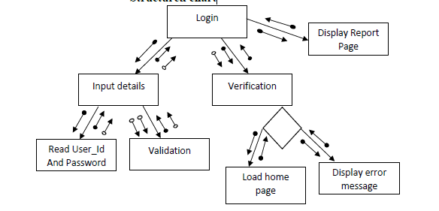
Module design of components
Login
Input
user_id, password
Procedure details
Structured chart

Slide 55
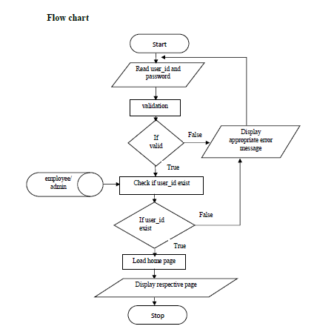
Algorithm
Step 1: start
Step 2: Input user_id and password.
Step 3: IF valid.
Load home page.
Display home page.
Go to step 4
ELSE
Display error message.
Go to step 2.
END IF
Step 4: END

Slide 56
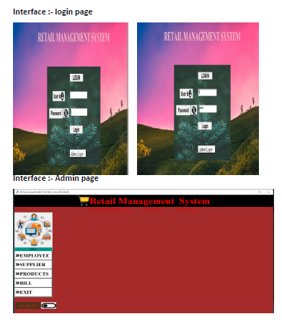
USER INTERFACE

Slide 57
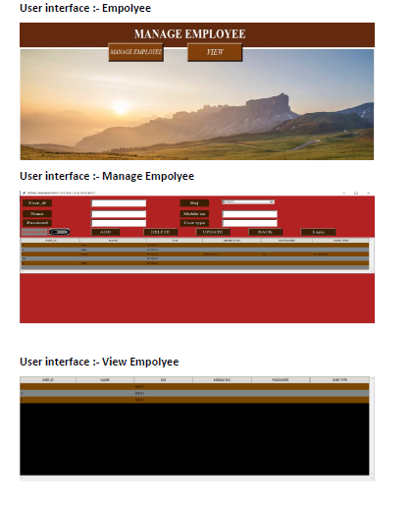

Slide 58
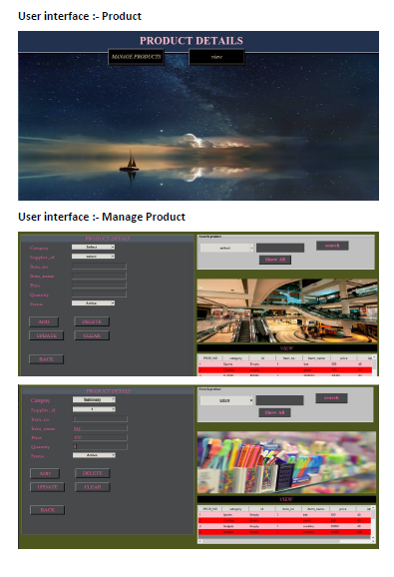

Slide 59
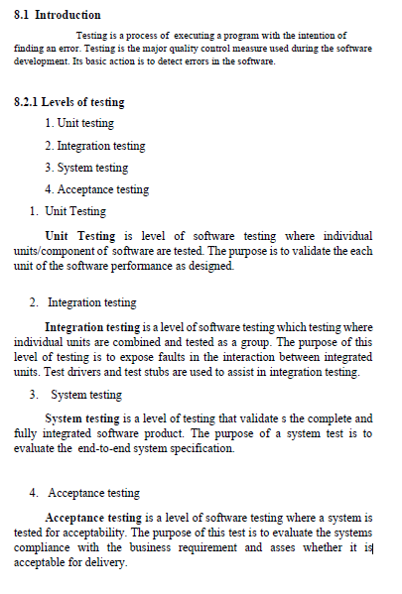
TESTING

Slide 60
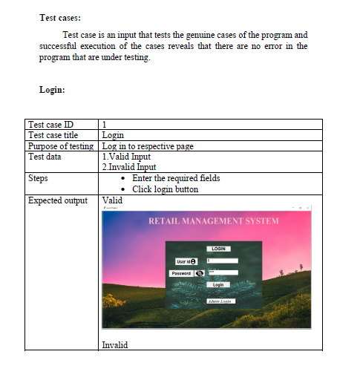

Slide 61
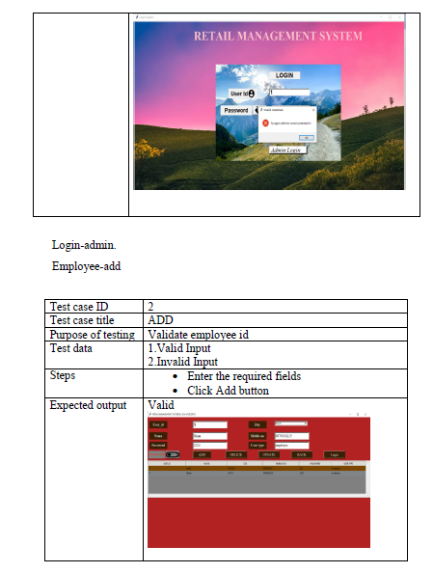

Slide 62
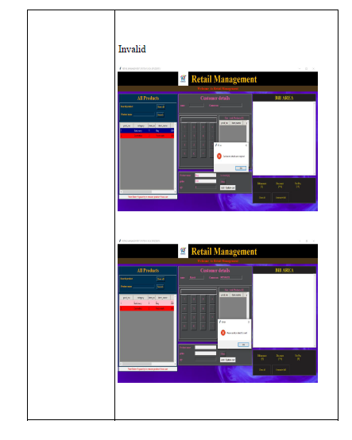

Slide 63
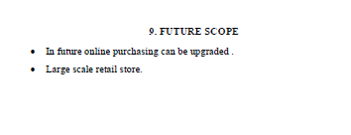
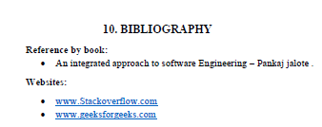

Slide 64

THANK YOU

